Slide 1
Lab 2: Sorting Under Real-World Constraints
Nigel Tavaguta (R236699C)

Slide 2
The workload
100 million transaction records per day
Sort by timestamp, amount, then merchant
Memory limit: 512 MB
Input is often partly sorted
Need stable behavior and protection from adversarial inputs
Question: Which sorting design gives good performance without a quadratic worst case or exceeding memory?

Slide 3
Algorithms compared
Algorithm | Worst time | Extra space | Stable | Adaptive
Merge sort | O(n log n) | O(n) | Yes | No
Lomuto / Hoare quicksort | O(n²) | O(log n) typical | No | No
Heapsort | O(n log n) | O(1) | No | No
Built-in Timsort | O(n log n) | O(n) | Yes | Yes
Timsort-style / hybrid | O(n log n) | O(n) merge path | Merge path | Yes
The benchmark also includes an in-place median-of-medians quicksort as a deterministic pivot defense.

Slide 4
Hybrid design
Scan for ascending and descending natural runs.
Reverse strictly descending runs.
Return after a single run, or merge neighboring runs in linear passes.
If runs are highly fragmented, use introsort.
In introsort, use insertion sort for short ranges and heapsort after the depth limit.
This exploits existing order while bounding worst-case work by O(n log n).

Slide 5
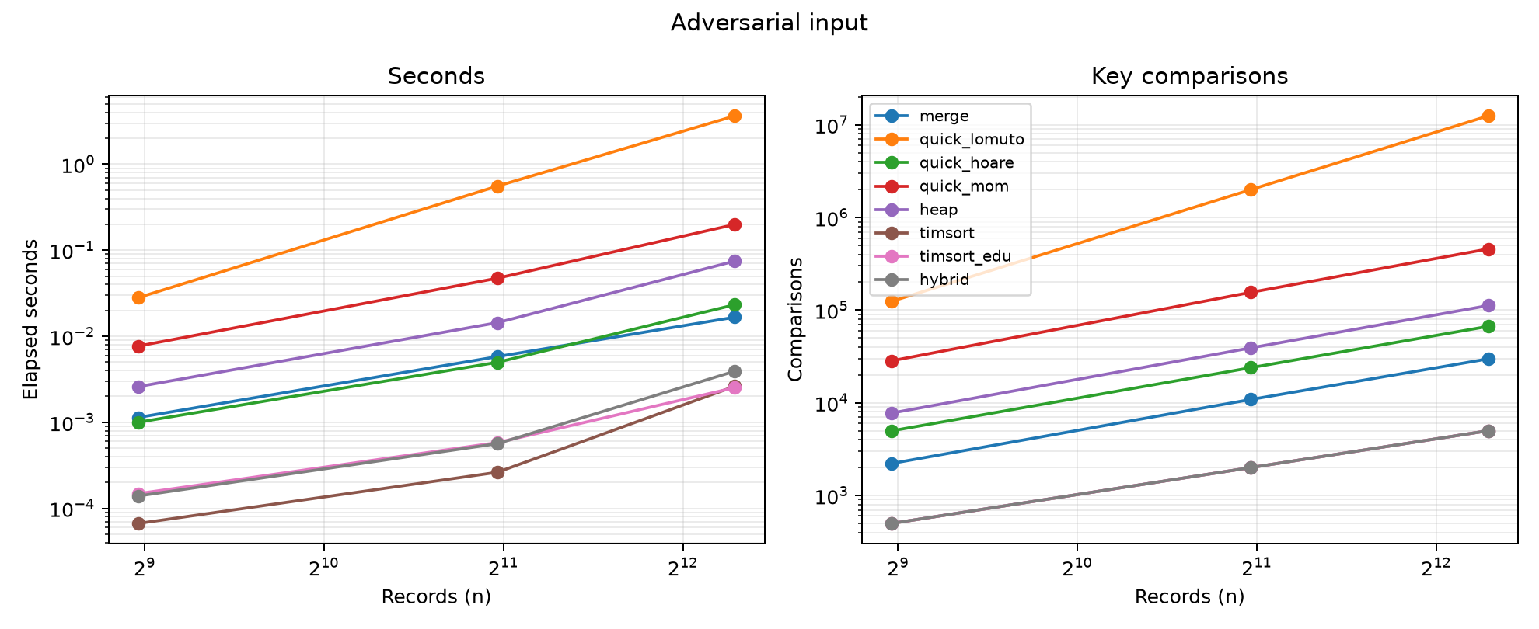
Adversarial quicksort
Lomuto chooses the last record as pivot.
On sorted or reverse-sorted input, it can split into sizes 0 and n−1.
Recurrence: Q(n) = Q(n−1) + Θ(n) = Θ(n²).
At n = 5,000: 12,497,500 key comparisons.
Median-of-medians guarantees a constant-fraction split; introsort uses a heap fallback.
Adversarial distribution benchmark

Slide 6
Experimental method
Five seeded inputs: random, sorted, reverse-sorted, nearly sorted, adversarial
Eight algorithms through n = 5,000
Six faster algorithms through n = 20,000
Three timing repetitions, reported as the median
Key comparisons counted in a separate run
Every output checked against Python’s stable sort

Slide 7
Results at n = 5,000
Algorithm | Random time (ms) | Sorted time (ms) | Random comparisons | Sorted comparisons
Lomuto quicksort | 17.29 | 3,551.95 | 68,052 | 12,497,500
Hoare quicksort | 20.94 | 15.62 | 91,249 | 66,807
Median-of-medians | 160.94 | 148.51 | 468,619 | 457,665
Built-in Timsort | 2.55 | 1.95 | 54,928 | 4,999
Educational Timsort-style | 25.10 | 1.96 | 56,642 | 5,000
Hybrid | 23.64 | 1.82 | 83,311 | 5,000
The Lomuto count matches n(n−1)/2 exactly on sorted input. Built-in Timsort is fast because its sort is implemented in optimized C.

Slide 8
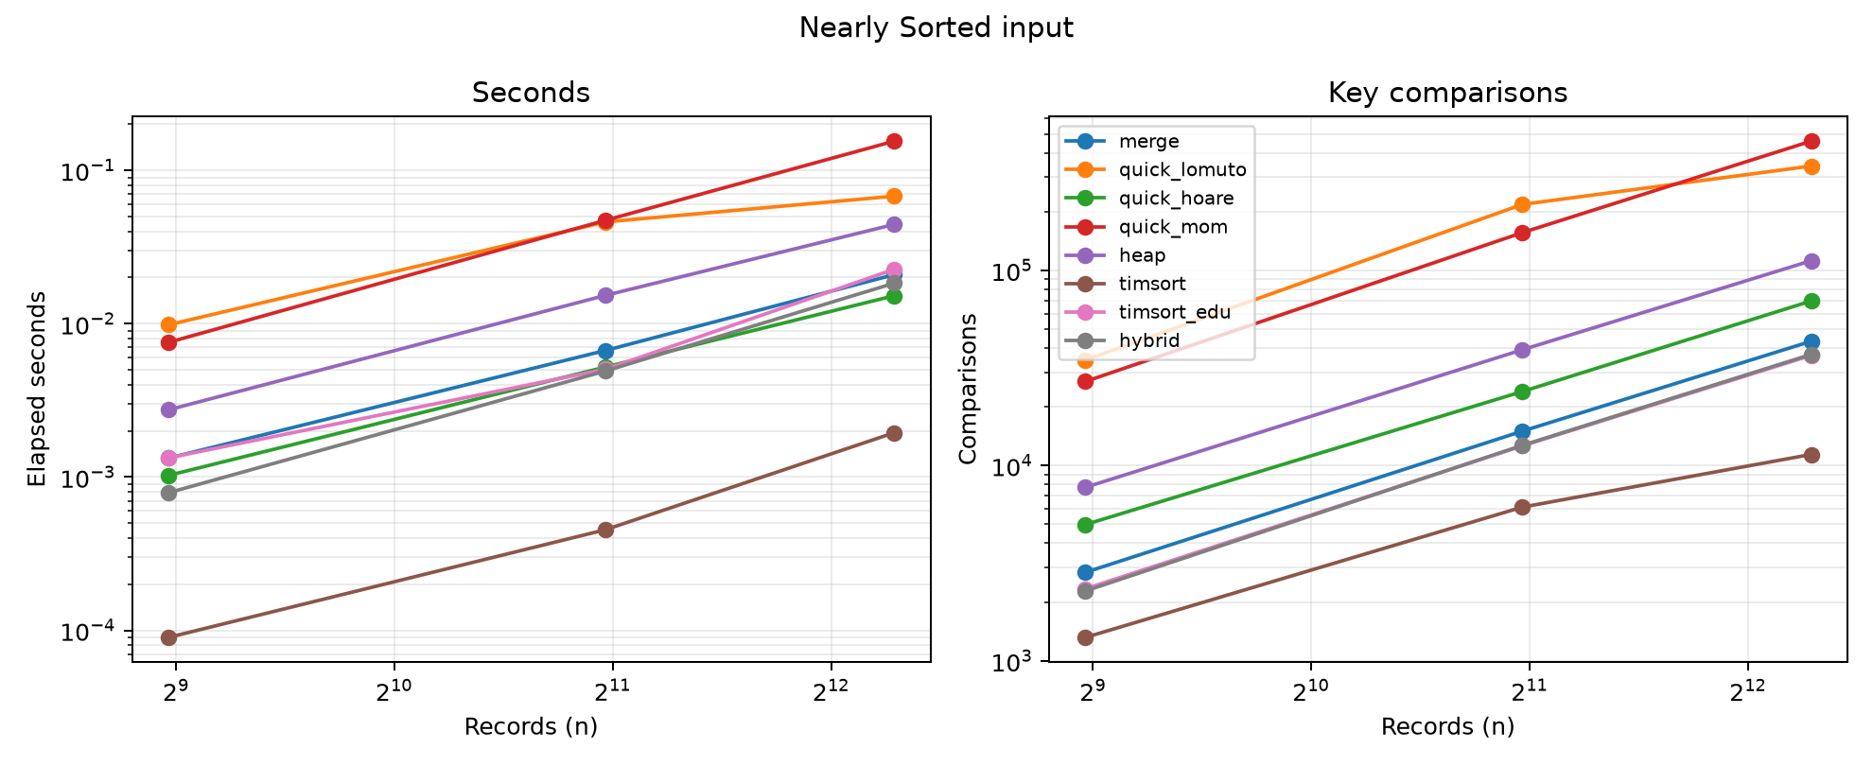
Partial presortedness
At n = 20,000, built-in Timsort used 46,984 comparisons on nearly sorted data. The educational version used 185,276 and the hybrid used 183,812.
Timsort and the hybrid detect natural runs and reduce work when the input is ordered. The educational version uses simple minrun and merge rules, so nearly sorted data costs more comparisons than the built-in implementation.
Nearly sorted distribution benchmark

Slide 9
External sorting for 100 million records
64 serialized bytes per record gives about 6.4 GB on disk.
Sort chunks under a 128 MiB estimated Python-object budget.
About 268,000 records per chunk at an estimated 500 bytes per row.
Roughly 374 sorted runs, merged with fan-in 32.
Run generation plus two merge levels gives about 6N/B block transfers.
Estimated sequential read/write traffic: about 38.4 GB.
The byte budget estimates memory. Peak process memory still needs measurement on representative records to validate the 512 MB ceiling.

Slide 10
Recommendation
Use external merge sort when the full batch exceeds RAM.
Use Timsort for stable in-memory Python sorting.
Use the hybrid when custom control and adaptivity are needed.
Avoid endpoint-pivot quicksort on untrusted or partly sorted feeds.
Measure peak RSS and timing on representative production records.
Takeaway: asymptotic bounds identify the risks; measured constants, stability, input structure, and memory determine the production choice.
References: Cormen et al. (2022); Musser (1997); Blum et al. (1973); Aggarwal and Vitter (1988).

